Slide 1
Pump Slow Control
Updated: 07/24/23

Slide 2
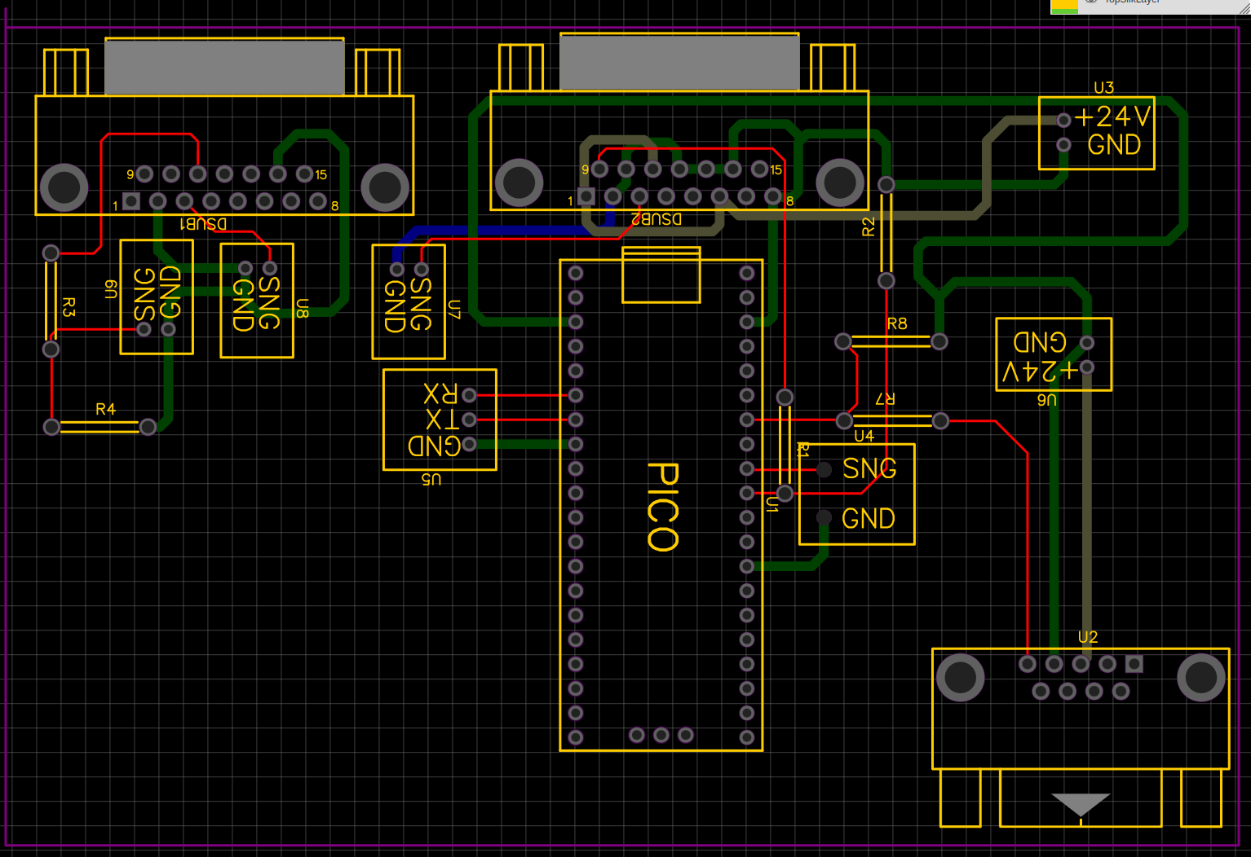

Slide 3
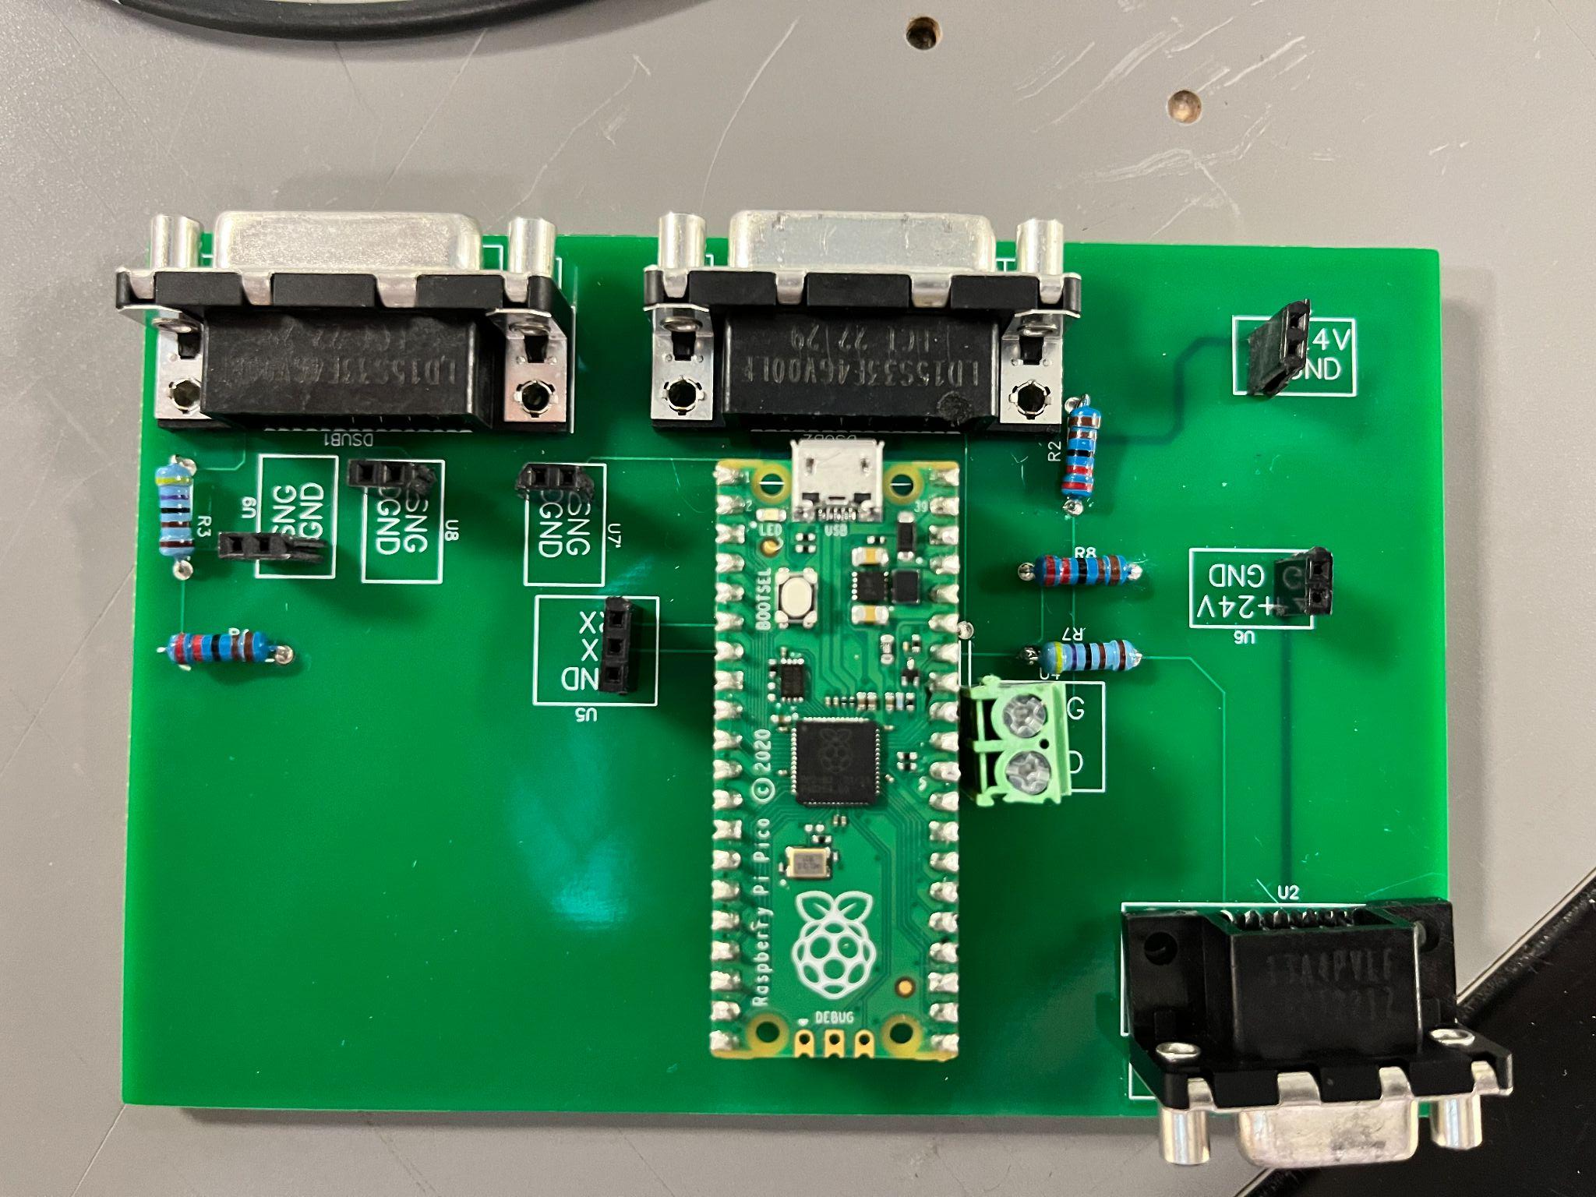

Slide 4
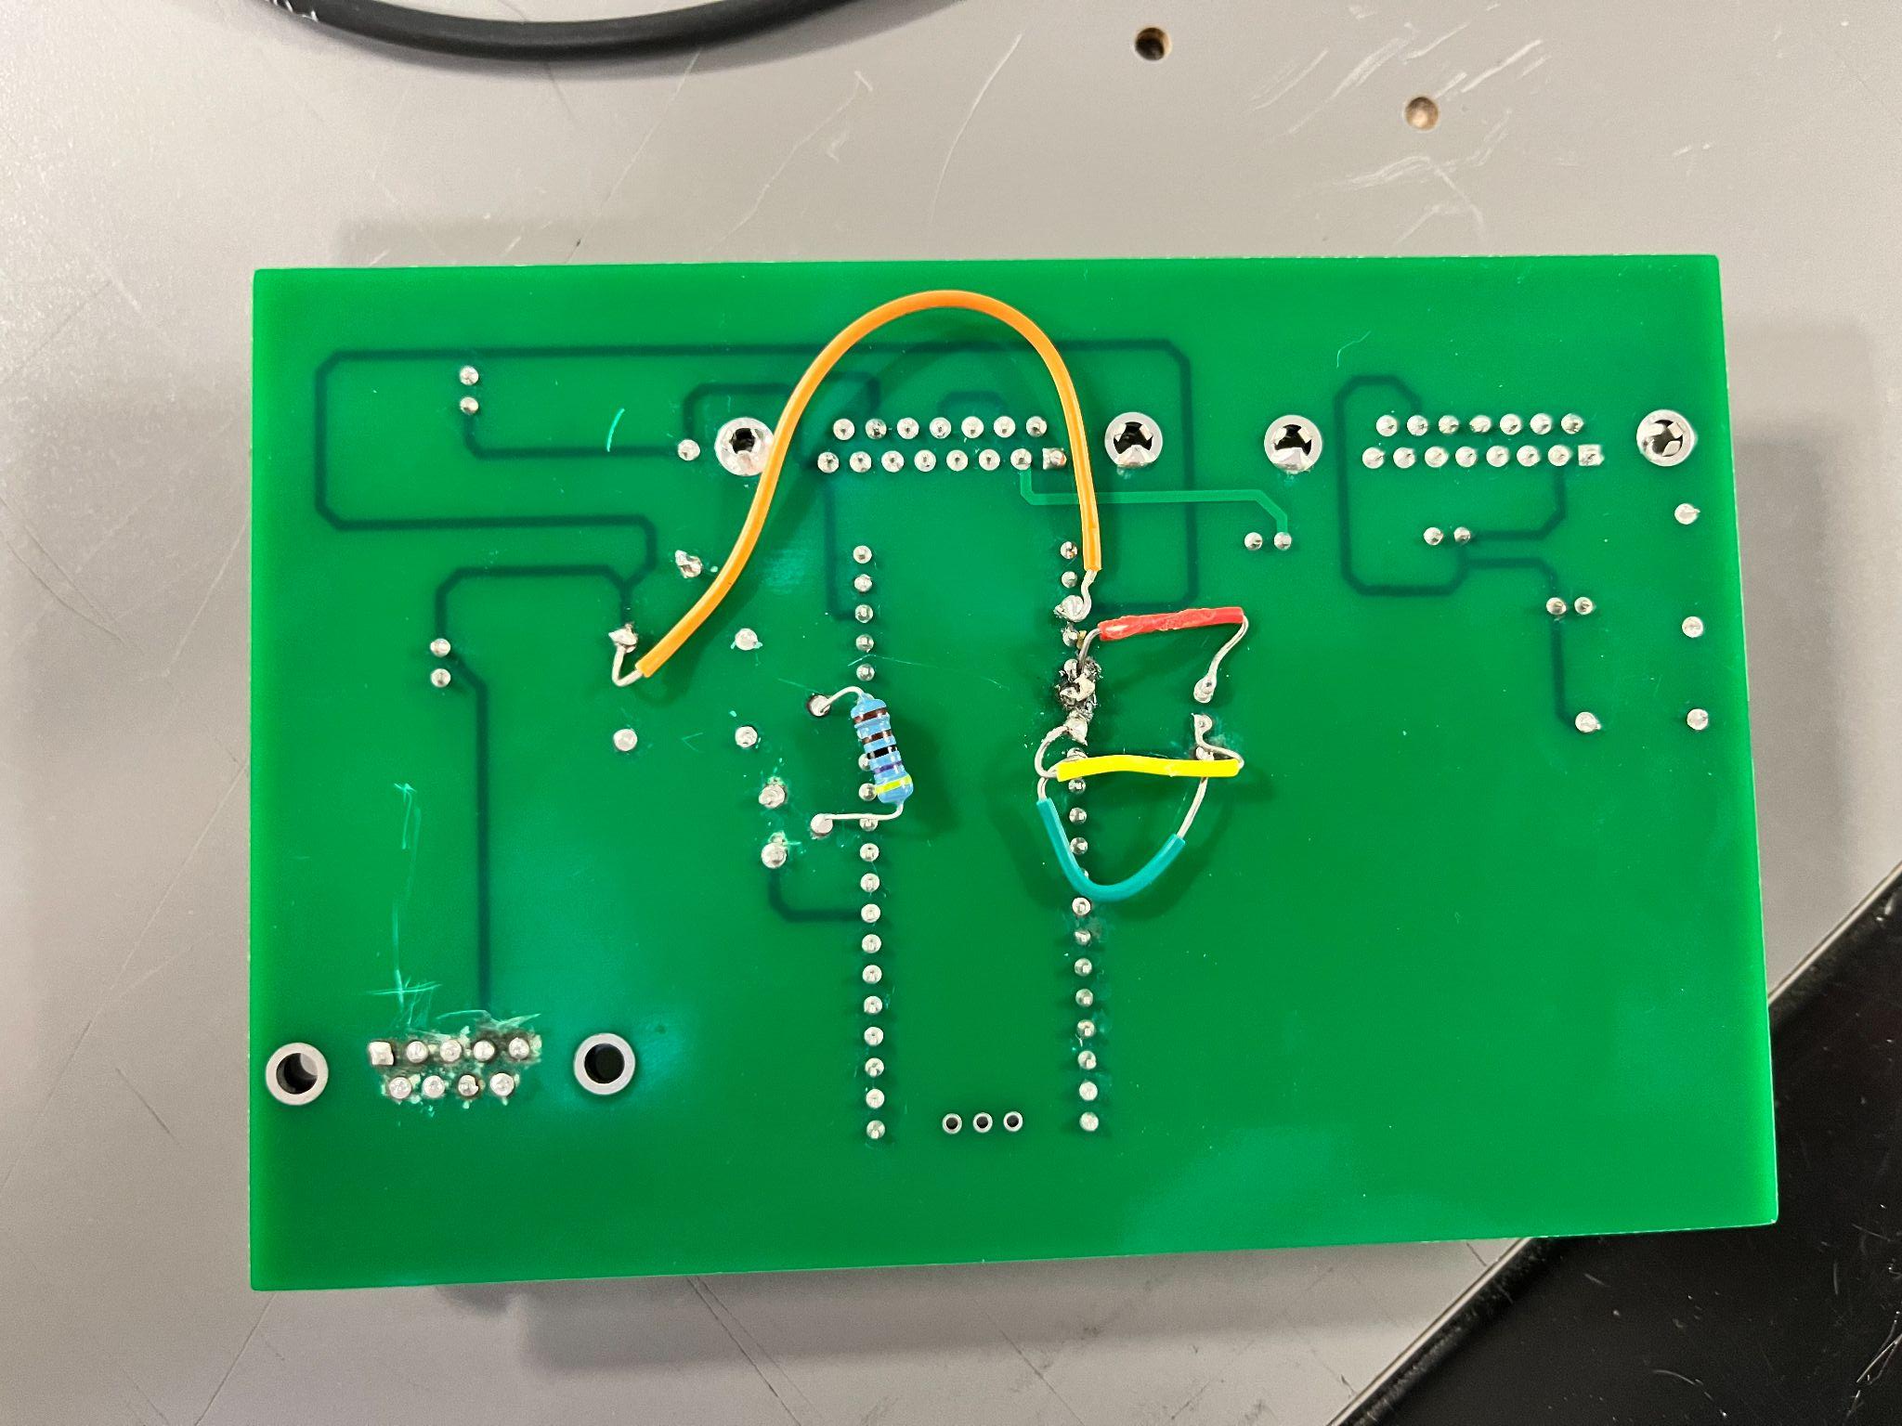

Slide 5
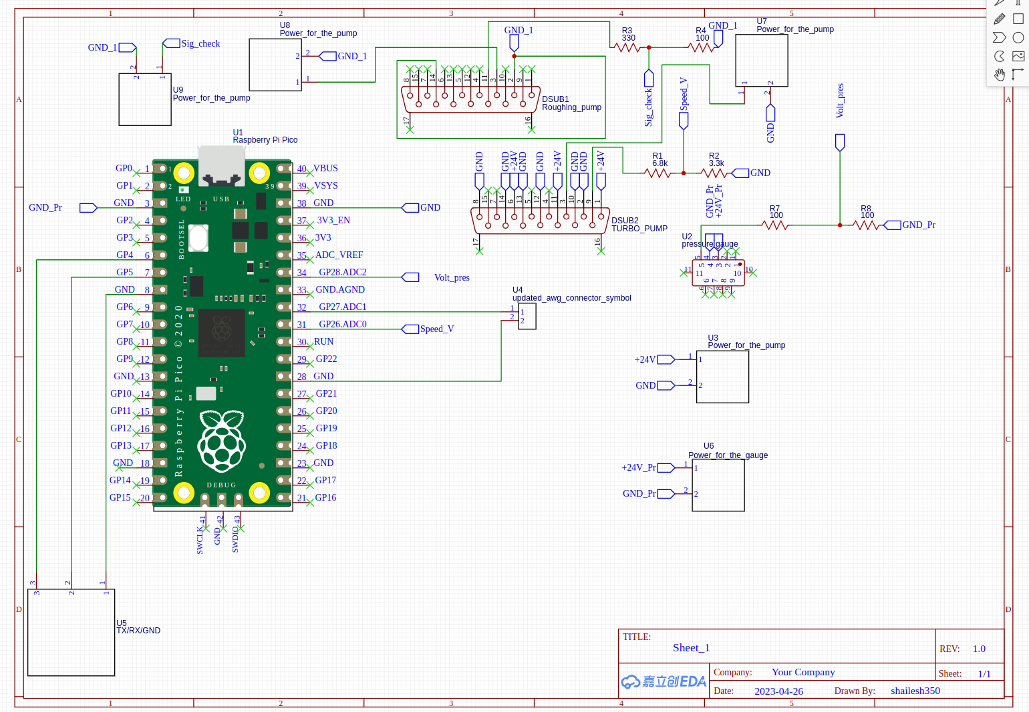

Slide 6
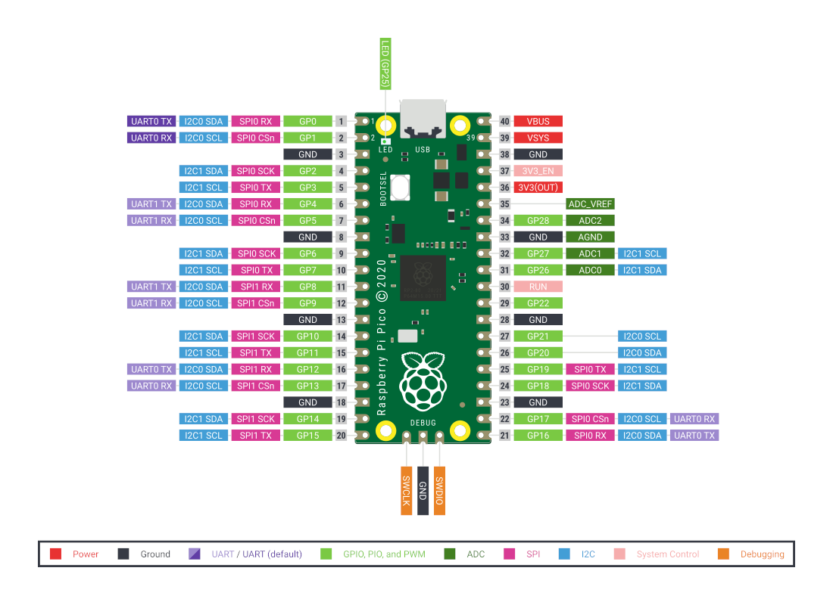

Slide 7
Steps to install software and GUI
sudo pip3 install pyqt6
pip install pyqt6-tools
To lauch the GUI designer
qt6-tools designer
The create your GUI and save the file as a “.ui” file and convert this to a python file using the command
pyuic6 -o test.py test.ui
pyuic6 is the command that converts a .ui file
-o does “...”
test.py is the name of your desired output file
test.ui is the name of the file you saved from the designer tool

Slide 8
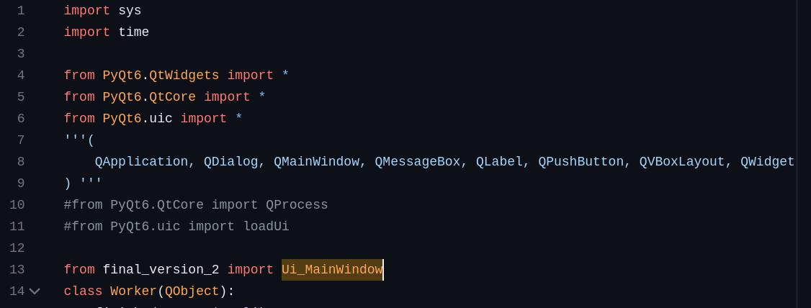
Steps to install software and GUI
Now you need to add functionality to the code structure you just created
Digital code lives here: https://github.com/giriPHM/Digital-Control-for-vacuum-maintenance-and-parameter-monitoring-.git
You can import the GUI you’ve created using this function

Slide 9
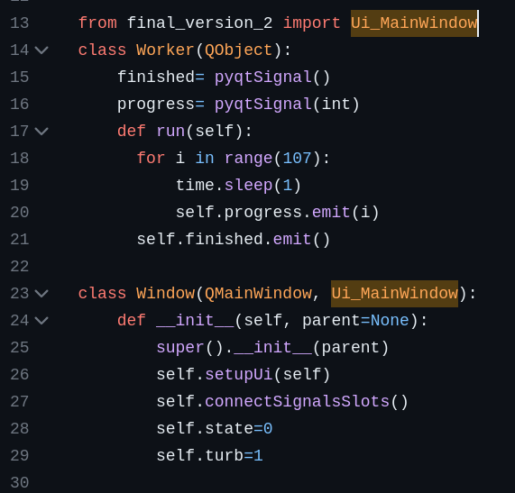
Steps to install software and GUI
Now you need to add functionality to the code structure you just created
Now you need to call the function “setupUI” in order to call the functions from the GUI
Then “connectSignalsSlots” connects the skeletons to the functions to talk to the hardware

Slide 10
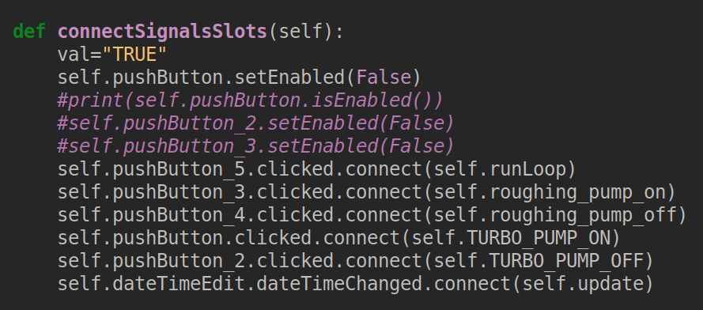
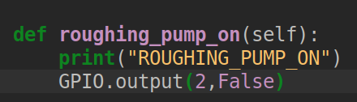
Take an example of how the functionality is applied
Here we are going to turn on the roughing pump by using
“self.pushButton_3.clicked.connect(self.roughing_pump_on)”
Which calls this function
This will set GPIO pin 2 to low which turns the pump on

Slide 11
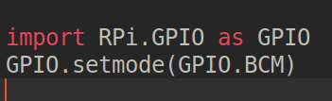

Take an example of how the functionality is applied
In order for this to work, we need the library for the Raspberry Pi which will load in the functionality of the GPIO pins and define the mapping of the GPIO pins
We also define the GPIO pin mode (either input or output)
We use the mapping defined on the next slide

Slide 12
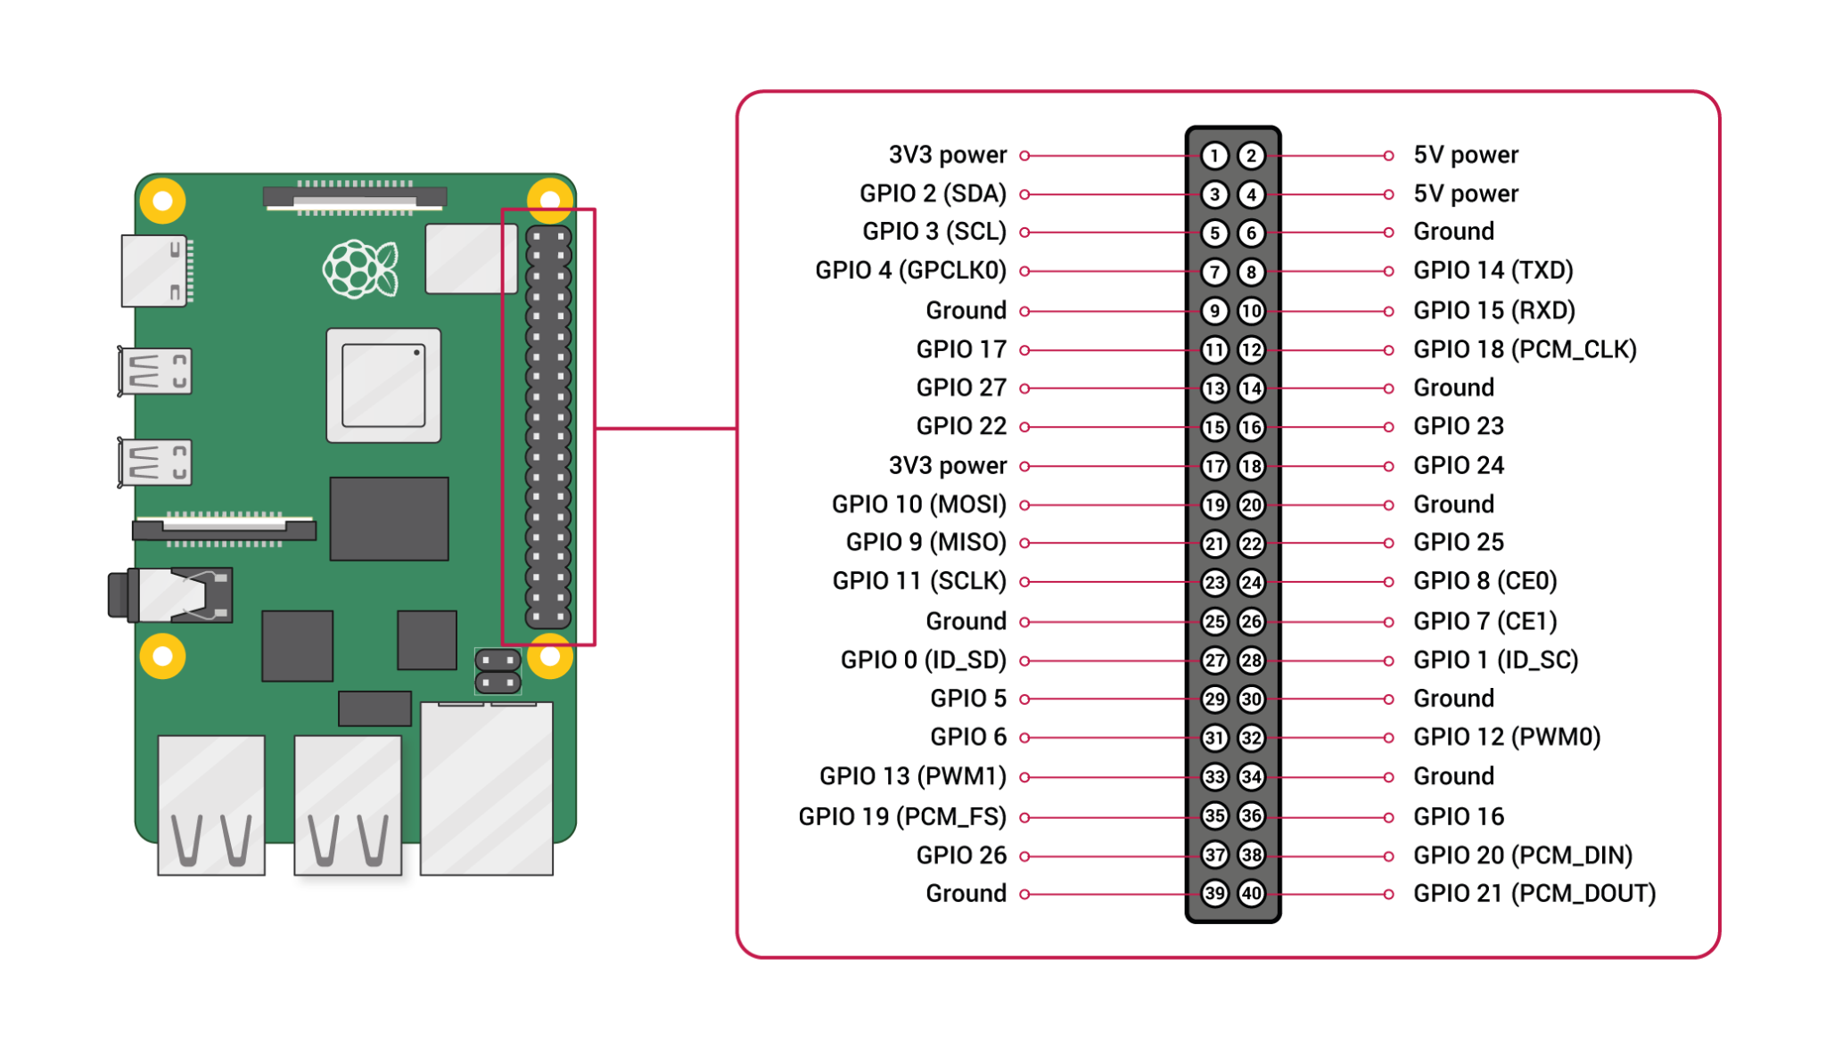
GPIO 2 is actually physical pin #3, but by using the “BCM” numbering scheme we just follow the GPIO label to determine which pin is which

Slide 13
This function sets this pin to “low” (0V, but conducting) which then transmits a 0V signal to the roughing pump, connecting the circuit and turning it on

Slide 14
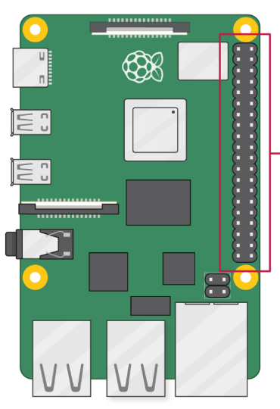
To the roughing pump

Slide 15
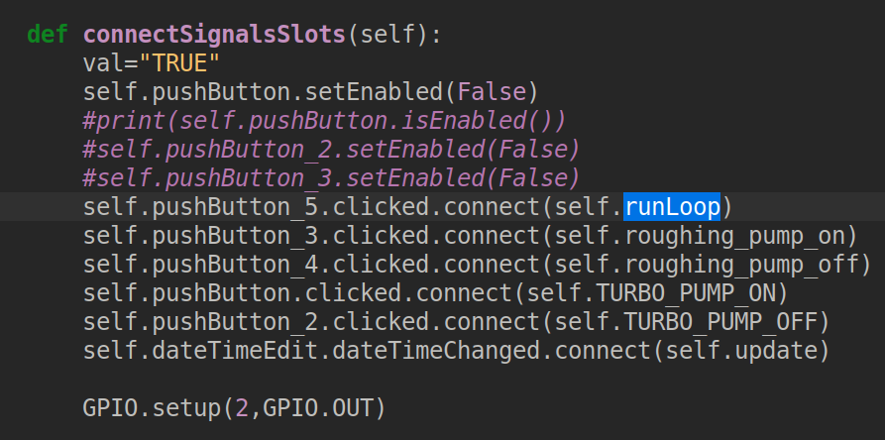
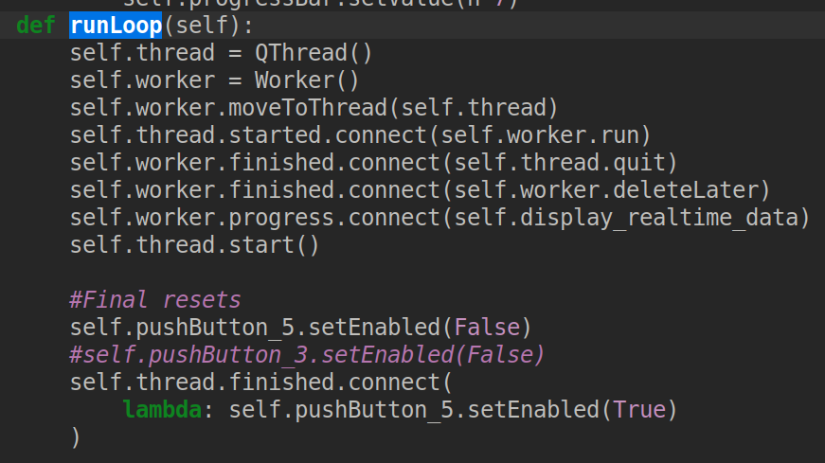
How to display the data
Since the GUI runs on a particular thread, if you want to add any functionality (e.g. retrieving the data) you need to add another thread
Otherwise the GUI will get stuck and won’t operate until the loop is finished
To solve this problem we initiate the function “runLoop” which creates and additional thread

Slide 16
This creates the thread you need to retrieve the data

Slide 17
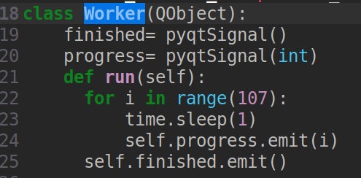
This is a function defined earlier that retrieves the data

Slide 18
This now moves this worker (retrieving the data) to another thread so it doesn’t cause the GUI to get stuck

Slide 19
Now you “run” the worker (which is defined in the class)

Slide 20
When you end the GUI, this ensures you both quit the thread and delete the thread

Slide 21
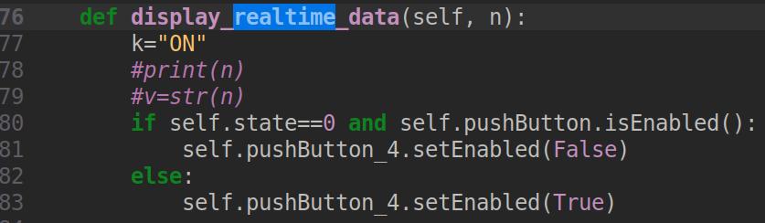
Now you display the data to the GUI

Slide 22
Now for the data acquisition sensors
fresh_start.py
(should be the first thing you run when you are starting things off)

Slide 23
You will connect the TXD (GPIO14) of the Raspberry Pi to the TX line on the PiPico board connector (the lines have been labeled according to the PI) and GND to GND (not shown below)

Slide 24
Note: The TX line of the Pi4 goes to the RX line of the pico
This is a RX line on the PICO

Slide 25
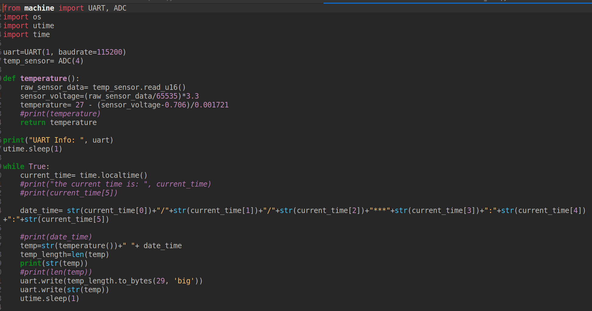
To gather the data being sent, you use

Slide 26
To gather the data being sent, you use
This gathers the sensor data in “bit form” and then converts that to a number (temperature)

Slide 27
To gather the data being sent, you use
This gets called here with the date and time which helps in splitting the data later on

Slide 28
Now to read the data that you just read

